Slide 1
External Material Implementation of Elastoplasticity with Linear Isotropic Hardening

Slide 2
External Materials in COMSOL Multiphysics
User-defined material models written in C-code can be used in COMSOL Multiphysics through an External Materials socket
This allows you to program your own material models and distribute them as add-ons
The code needs to be compiled into a shared library (e.g., dll for Windows)
Use on Linux and Mac OS X requires recompilation of the source code
For further details, see the section Working with External Materials in the COMSOL Multiphysics Reference Manual as well as the section Using External Materials in the documentation of the Structural Mechanics Module.
The latter also includes documentation of a library of utility functions that is available in order to simplify the implementation

Slide 3
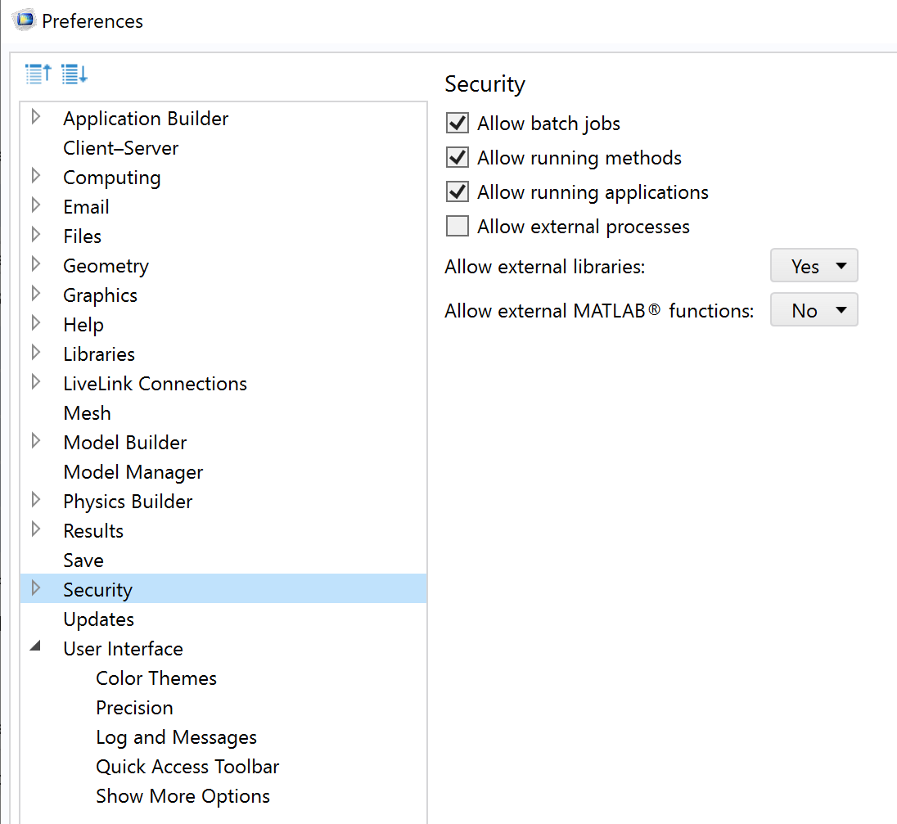
Working with External Materials in COMSOL Multiphysics
Before starting, go to File->Preferences->Security and set “Allow external libraries” to Yes.
For security reasons, external processes and libraries are disabled by default in a new COMSOL Multiphysics installation

Slide 4
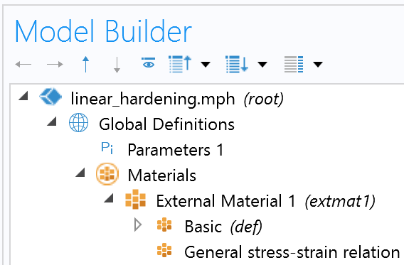
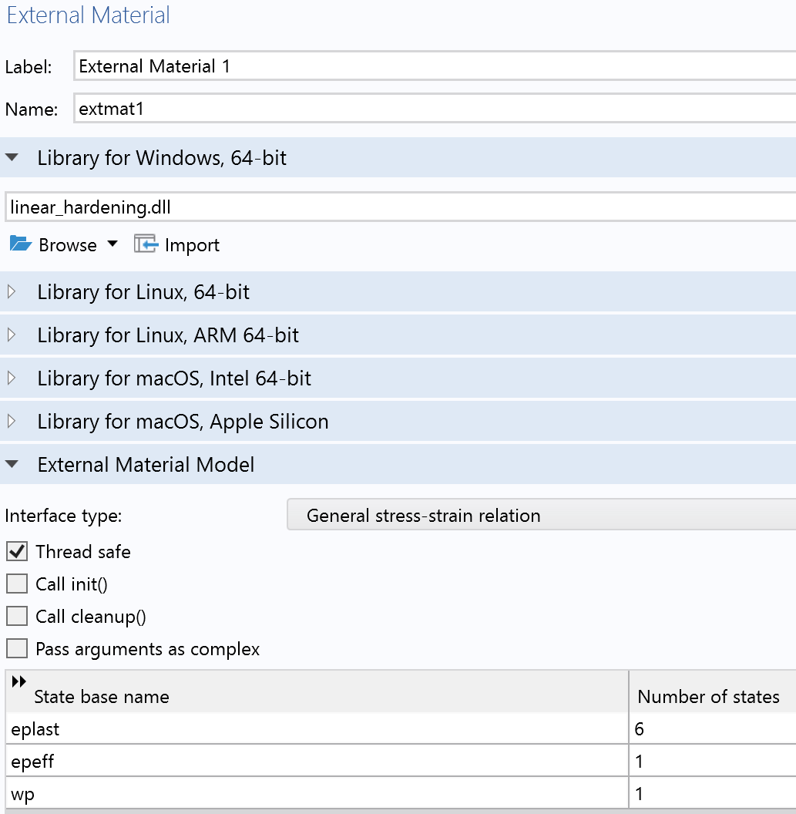
Linking an External Material
In the Materials node under Global Definitions, add an External Material
In the settings window, link the shared library according to the system architecture
Select the interface type according to the type of material relation you have implemented
Add the state variables as arguments
eplast : plastic strain tensor (6 components)
epeff : equivalent plastic strain (scalar)
wp : plastic work

Slide 5
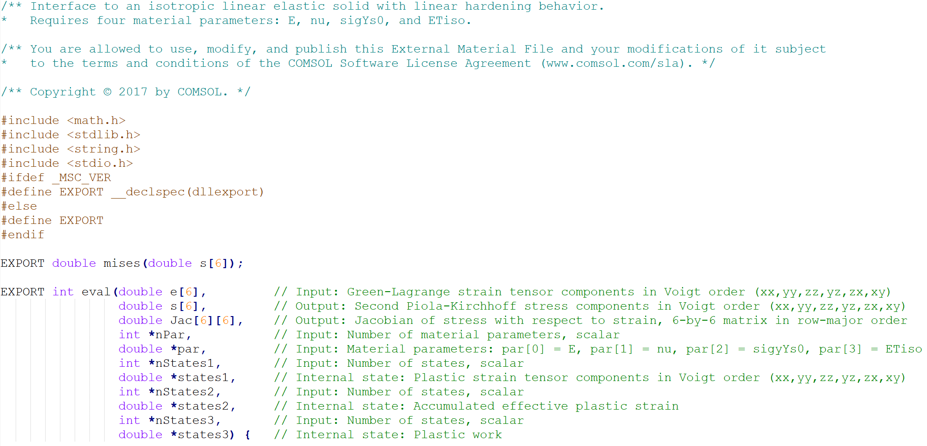
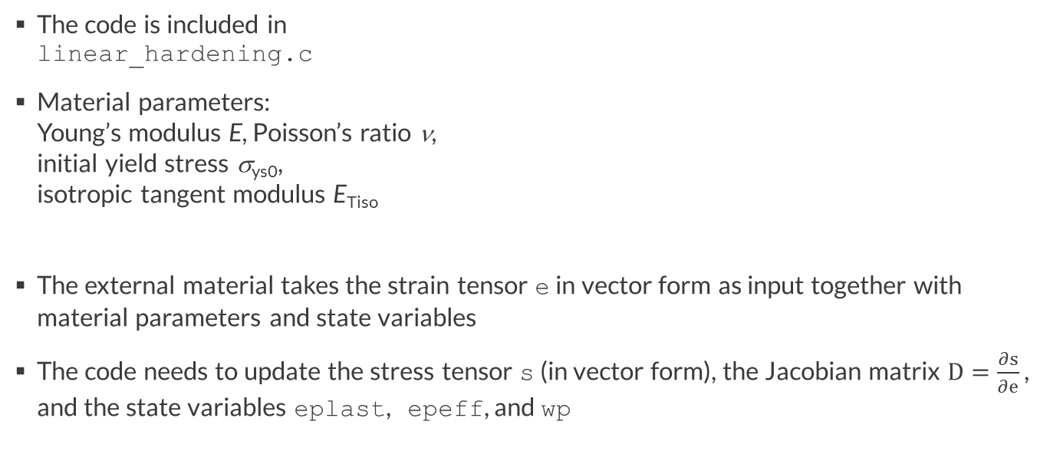
Example: Elastoplasticty with Linear Isotropic Hardening
The code is included in linear_hardening.c
Material parameters: Young’s modulus E, Poisson’s ratio ν, initial yield stress σ_{ys0}, isotropic tangent modulus E_{Tiso}
The external material takes the strain tensor e in vector form as input together with material parameters and state variables
The code needs to update the stress tensor s (in vector form), the Jacobian matrix $D=\frac{∂s}{∂e}$ , and the state variables eplast, epeff, and wp

Slide 6
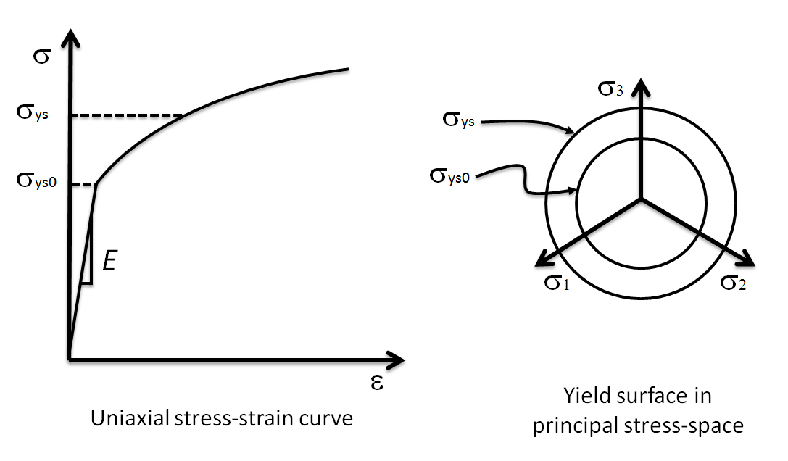
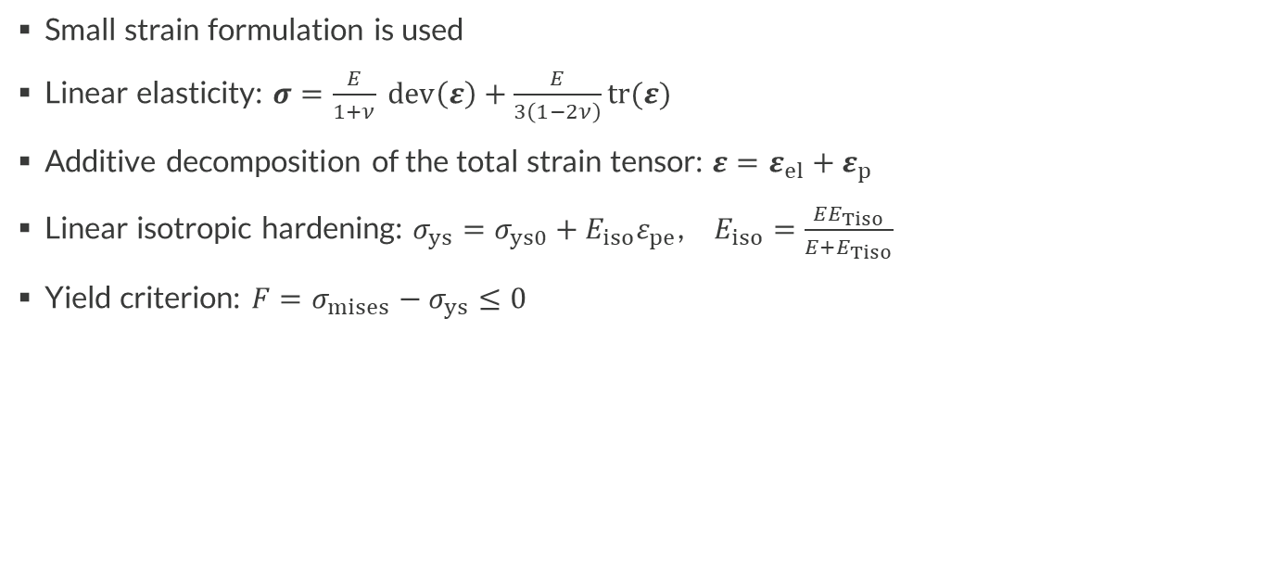
Constitutive Equations
Small strain formulation is used
Linear elasticity: $σ=\frac{E}{1+ν} dev\left(ε\right)+\frac{E}{3\left(1−2ν\right)}tr(ε)$
Additive decomposition of the total strain tensor: $ε=ε_{el}+ε_{p}$
Linear isotropic hardening: $σ_{ys}=σ_{ys0}+E_{iso}ε_{pe}$, $E_{iso}=\frac{EE_{Tiso}}{E+E_{Tiso}}$
Yield criterion: $F=σ_{mises}−σ_{ys}≤0$

Slide 7
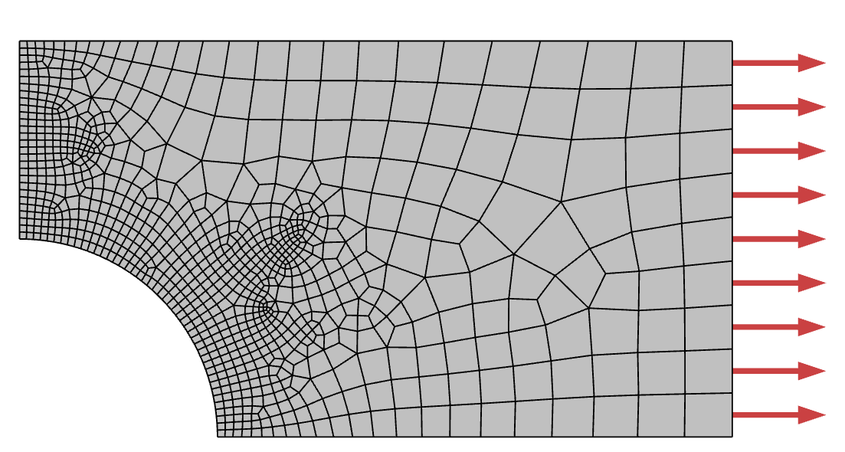
Validation with Built-in Implementation
The External Material code is validated against the built-in implementation of a Linear Elastic Material with linear isotropic hardening Plasticity in COMSOL Multiphysics
To associate the External Material to a domain, add an External Stress-Strain Relation feature under the Solid Mechanics interface
The results from the two implementations are compared for a thin plate with a hole loaded beyond the elastic limit
Note that the External Stress-Strain Relation feature will force the study to be geometrically nonlinear; to force the use of small strains, enable the checkbox Geometrically linear formulation in the External Stress-Strain Relation settings window
18 mm
130 MPa
10 mm
R = 5 mm

Slide 8
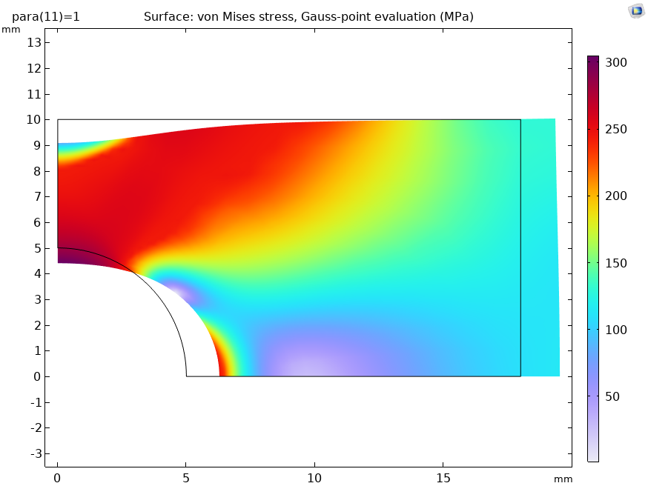
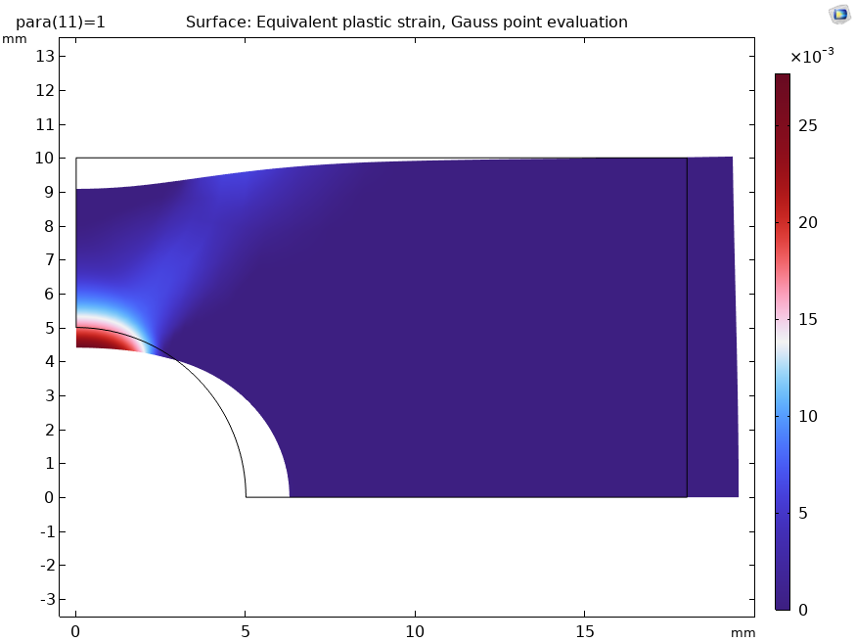
Results
Note: Use variables evaluated at Gauss points for postprocessing, for example, solid.misesGp for the equivalent stress and solid.gpeval(extmat.state.epeff1) or solid.epeGp (for the built-in material) for the equivalent plastic strain

Slide 9
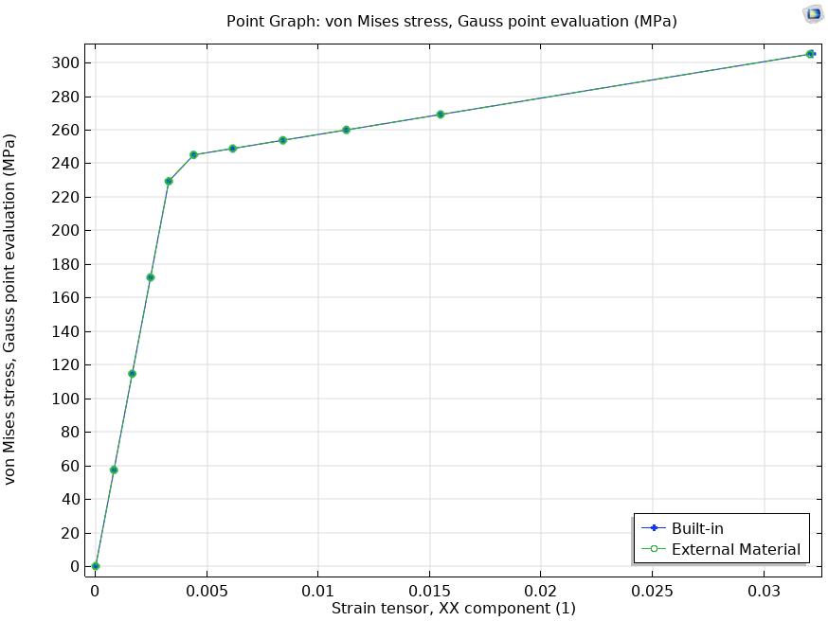
Results
The stress-strain relation at the top of the hole (point with maximum stress concentration) is in excellent agreement between the two implementations

